Slide 1
Neural Net Report
Your Name: Lucas Luwa
Your GT Username: lluwa3

Slide 2
Question 5: Learning With Restarts
testPenData:
Max accuracy: 0.9102344196683819
Average accuracy: 0.8999428244711263
Standard deviation: 0.008338615247097609
testCarData:
Max accuracy: 0.995
Average accuracy: 0.985
Standard deviation: 0.008944271909999166

Slide 3
Question 6: Varying the Hidden Layers
Statistic table for testPenData – report the max, average, and standard deviation at various amount of perceptrons.
 | Number of Perceptrons at the Hidden Layer
 | 0 | 5 | 10 | 15 | 20 | 25 | 30 | 35 | 40
Max Accuracy | 0.0 | 0.8525 | 0.8991 | 0.9097 | 0.9091 | 0.9097 | 0.9054 | 0.9045 | 0.9039
Avg Accuracy | 0.0 | 0.8440 | 0.8915 | 0.9017 | 0.9071 | 0.9058 | 0.9002 | 0.9034 | 0.9003
Standard Deviation | 0.0 | 0.0065 | 0.0060 | 0.0065 | 0.0013 | 0.0027 | 0.0074 | 0.0008 | 0.0022

Slide 4
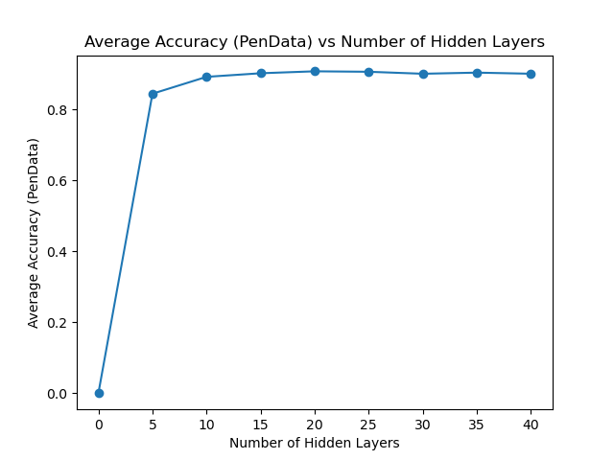
Question 6: Varying the Hidden Layers
Create a learning curve for testPenData where the number of hidden layer perceptrons is the independent variable and the average accuracy is the dependent variable.
[attach your image/graph here]

Slide 5
Question 6: Varying the Hidden Layers
For testPenData, discuss any notable trends you saw related to increasing the size of the hidden layers in your neural net.
Answer: There is a very noticeable jump in accuracy from 0 to 5 hidden layers. However, after this, the accuracy increases slightly before plateauing out at around 90%. It seems that the optimal number of hidden layers is between 10 and 15 layers since additional layers after this don’t really benefit the model and really only adds extra complexity to something that could be accomplished with fewer layers. Overall, accuracy is affected by the number of hidden layers, but adding more layers after a certain point doesn’t necessary help us improve accuracy further.

Slide 6
Question 6: Varying the Hidden Layers
Statistic table for testCarData – report the max, average, and standard deviation at various amount of perceptrons.
 | Number of Perceptrons at the Hidden Layer
 | 0 | 5 | 10 | 15 | 20 | 25 | 30 | 35 | 40
Max Accuracy | 0.71 | 0.97 | 0.99 | 0.99 | 0.98 | 0.985 | 0.99 | 0.99 | 0.99
Avg Accuracy | 0.71 | 0.967 | 0.985 | 0.985 | 0.976 | 0.978 | 0.987 | 0.98 | 0.974
Standard Deviation | 0.0 | 0.0024 | 0.0032 | 0.0077 | 0.0037 | 0.0051 | 0.0024 | 0.0071 | 0.0097

Slide 7
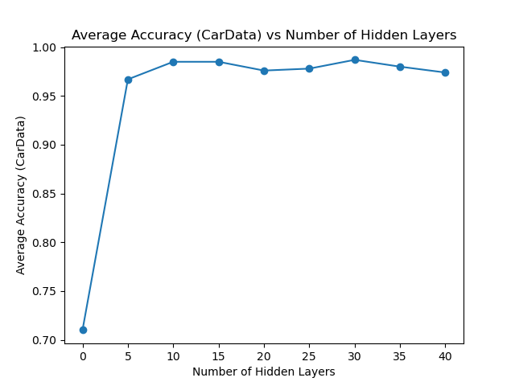
Question 6: Varying the Hidden Layers
Create a learning curve for testCarData where the number of hidden layer perceptrons is the independent variable and the average accuracy is the dependent variable.
[attach your image/graph here]

Slide 8
Question 6: Varying the Hidden Layers
For testCarData, discuss any notable trends you saw related to increasing the size of the hidden layers in your neural net.
Answer: Just like the previous graph, there is a very noticeable jump in accuracy from 0 to 5 hidden layers. After this initial spike, the accuracy increases slightly before plateauing out in the range of 96-99%. It seems that the optimal number of hidden layers is around 10 layers since adding more layers after this don’t really benefit the model and really only adds extra complexity to something that could be accomplished with fewer layers. Overall, accuracy is affected by the number of hidden layers, but adding more layers after a certain point doesn’t necessary help us improve accuracy further, which is similar to the situation in the previous testPenData model.

Slide 9
Question 7 (extra credit): Learning XOR
Report the max accuracy, average accuracy, and standard deviation of the neural net that you have trained with 1) no hidden layer, and 2) a hidden layer with various amount of perceptrons (at least 3 different amounts)
 | No Hidden Layer | Hidden Layer
 |  | 15 perceptrons | 35 perceptrons | 45 perceptrons
Max Accuracy | 0.5 | 0.75 | 1.0 | 1.0
Avg Accuracy | 0.3 | 0.5 | 0.8 | 0.95
Standard Deviation | 0.24494897427831 | 0.2738612787525 | 0.187082869338 | 0.1

Slide 10
Question 7 (extra credit): Learning XOR
Report the behavior of the trained neural net without a hidden layer.
Answer: When we run the neural net without a hidden layer, we get rather abysmal results. The high is a 0.5 and the average is 0.3 accuracy. Additionally, we see the standard deviation sit at around a .24. None of these values are particularly nice and indicate that our neural net is not able to properly learn from the data. However, this is to be expected since there aren’t any hidden layers to help us improve the accuracy of our trained neural net. As we add more layers to our neural net, we can expect all of these metrics to improve as the neural net’s capacity to learn is increased.

Slide 11
Question 7 (extra credit): Learning XOR
Report the behavior of the trained neural net with a hidden layer. Are the results what you expected? Explain your observation.
Answer: When running the trained neural net with a hidden layer, we see that the statistics drastically improve. As we increase the number of perceptrons from 15 to 45, we can see the accuracy go from 0.5 to 0.95. Additionally, both 35 and 45 perceptrons have a maximum of 1.0. Lastly, we see the standard deviation drop from around 0.27 to 0.1 as we add more layers to the neural net. In this case, this is expected. Adding additional layers increases the ability for our neural net to learn from the data, which is why we see such a dramatic increase in accuracy. Since I had expected the accuracy to improve as we added more layers, I can say that these results are in line with what I had expected.

Slide 12
Question 8 (extra credit): Novel Dataset
List the name and the source of the dataset that you’ve chosen.
Name: Letter Recognition
Source (e.g., URLs): https://archive.ics.uci.edu/dataset/59/letter+recognition
Briefly describe the dataset: This set consists of 16 primitive numerical attributes (stastical moments and edge counts), which were converted from 20 different fonts and all 26 letters. The set consists of a random assortment of these, totalling around 20,000 individual points. After scaling the elements to fit, they are then converted to the numbers you can see in the document with the actual letter on the right side. Due to the complexity of the set, getting a high accuracy proved to be rather difficult.

Slide 13
Question 8 (extra credit): Run Stats
Max accuracy: 0.7725
Average accuracy: 0.74945
Standard deviation: 0.0171481777457548

Slide 14
Question 8 (extra credit): Novel Dataset
Describe how to run the code that you’ve set up to train the selected dataset.
Answer: To run my code, all you have to do is run the q8.py file. This file currently just has the default settings, but can be changed easily to decrease or increase the number of Hidden Layers. This file makes a call to Testing.py, which is where the testExtraData function resides. This utilizes the function I added to NeuralNetUtil, which has the implementation I added to run my code. From the original data set, I created a function to randomly select lines to be a part of the test set and the rest as part of the training set. Both of these files are included in my programming submission. In short, I have provided all the files needed to run my code in my main submission with q8 as my main runner file for this extra credit question.

